Slide 1

Olist E-Commerce Data Analysis
By - Yash Jagtap
Mrutyunjay Panda
Meghana Patil

Slide 2
Introduction
Olist is a leading Brazil-based e-commerce company that connects small businesses to major online marketplaces.
It helps sellers list products, manage logistics, and ensure smooth order fulfillment across Brazil.
The dataset includes multiple years of data covering orders, customers, products, payments, and reviews.
The analysis aims to understand sales performance, delivery timelines, and customer satisfaction.

Slide 3
Objectives
To analyze sales performance and customer behavior across regions.
To evaluate delivery time, payment modes, and review patterns.
To visualize KPIs using Excel, Power BI, Tableau & SQL dashboards.
To recommend data-driven strategies for Olist’s business growth.

Slide 4




Tools Used
Excel : Static KPI dashboard and regional/product sales analysis
PowerBI : Interactive, dynamic dashboard with DAX-based KPIs
Tableau : Advanced visualization and drilldown storytelling
MySQL : Used to extract, clean and analyze raw data through SQL queries.

Slide 5
Methodology
Data Collection
Data Cleaning
Data Analysis using Excel and SQL
Data Visualization using PowerBI and Tableau
Insights and Conclusion

Slide 6
Key KPIs Measured
Total Sales – 16..01M
Weekday Sales - $12.2M
Weekend Sales - $3.6M
Total Profit – 2.42M
Total Unique Customers –96.10K
Total Sellers – 3094
Unique Products – 71
Average Delivery Days to Sao Paulo – 23.70 Days
Average Sales (São Paulo) – 154.10
Review Score - 99224

Slide 7
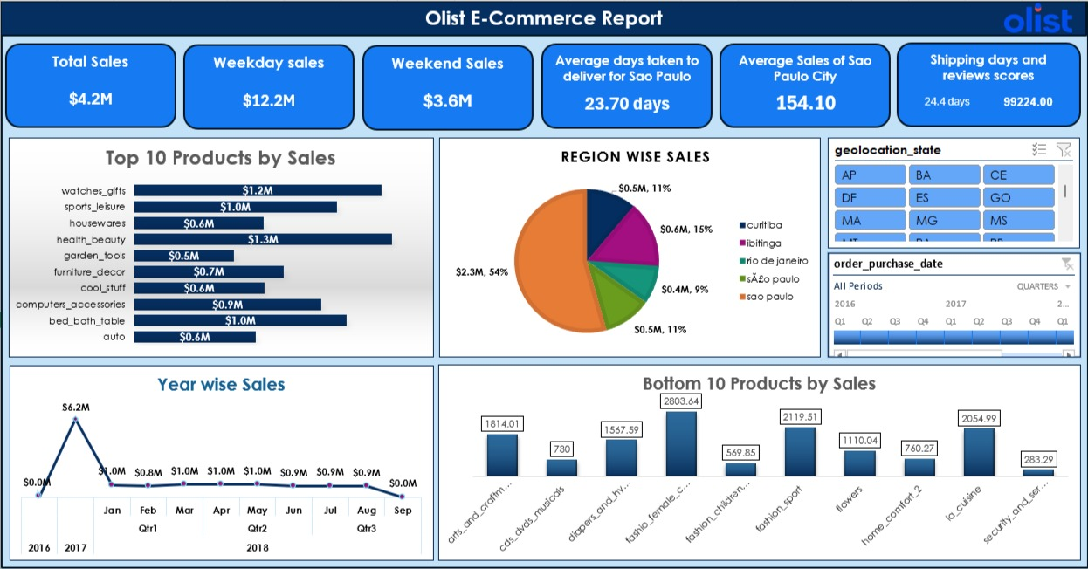
Excel Dashboard

Slide 8
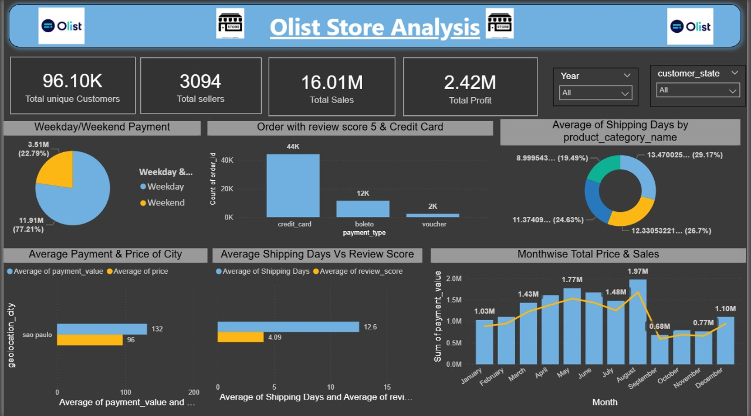
Power BI Dashboard

Slide 9
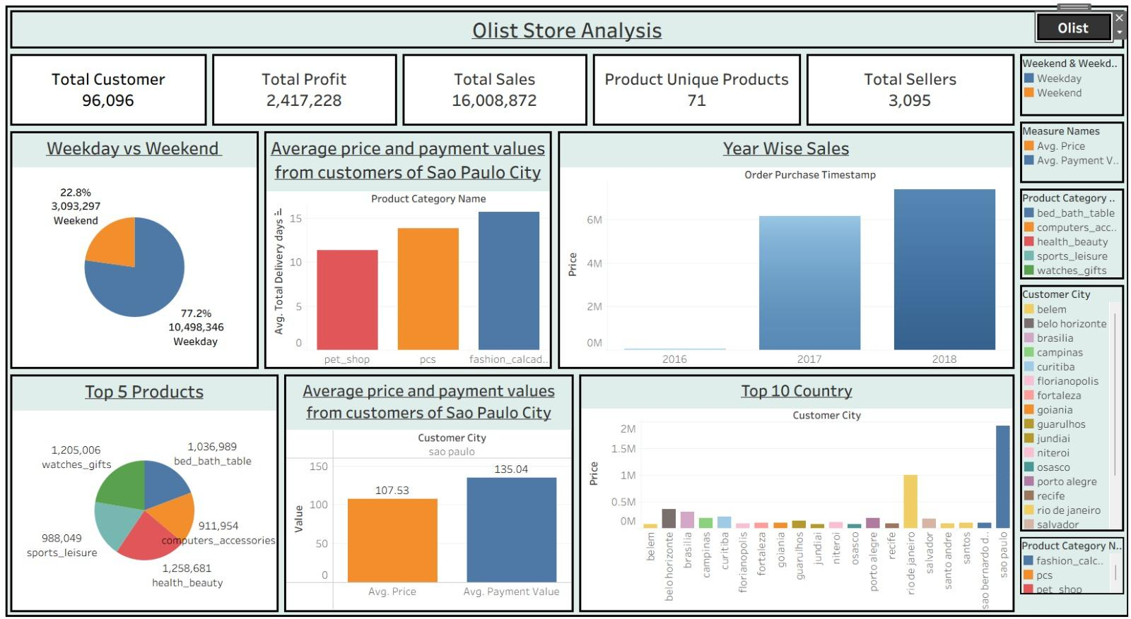
Tableau Dashboard

Slide 10
SQL Queries
Create database Olist ;
use olist;
# 1 - KPI
# Weekday Vs Weekend (order_purchase_timestamp) Payment Statistics.
select
case when DAYOFWEEK(str_to_date(o.order_purchase_timestamp, '%Y-%m-%d')) IN (1, 7) THEN 'Weekend' Else 'Weekday' END AS DayType,
count(distinct o.order_id) AS TOTALOrders,
round(sum(p.payment_value)) AS TOTALPayments,
round(AVG(p.payment_value)) AS AveragePayment
From
orders o
Join
orderpayments p ON o.order_id=p.order_id
group by
DayType;

Slide 11
SQL Queries
# 2 - KPI
# Number of Orders with review score 5 and payment type as credit card.
SELECT
COUNT(DISTINCT p.order_id) AS NumberOforders
FROM
orderpayments p
JOIN
orderreviews r ON p.order_id = r.order_id
WHERE
r.review_score = 5
AND p.payment_type = 'credit_card';

Slide 12
SQL Queries
#3rd--KPI
# Average number of days taken for order_delivered_customer_date for pet_shop.
SELECT
product_category_name,
round(AVG(datediff(Order_Delivered_Customer_Date, Order_Purchase_Timestamp))) AS avg_delivery_time
FROM
orders o
Join
orderitems i ON i.order_id= o.order_id
Join
products p ON p.product_id=i.product_id
Where
p.product_category_name='pet_shop'
AND o.order_Delivered_Customer_Date IS NOT NULL;

Slide 13
SQL Queries
#4th-- KPI
# Average price and payment values from customers of sao paulo city.
With orderItemsAvg AS(
Select round(AVG(i.price)) AS avg_order_item_price
from orderitems i
join orders o ON i.order_id = o.order_id
join customers c ON o.customer_id = c.customer_id
where c.customer_city = "sao paulo"
)
select
(select avg_order_item_price from orderItemsAvg) AS avg_order_item_price,
round(AVG(p.payment_value)) AS avg_payment_value
from orderpayments p
join orders o ON p.order_id = o.order_id
join customers c ON o.customer_id = c.customer_id
where c.customer_city = "sao paulo";

Slide 14
SQL Queries
#5th-- KPI
#Relationship between shipping days (order_delivered_customer_date - order_purchase_timestamp) Vs review scores.
SELECT
round(AVG(DATEDIFF(Order_Delivered_customer_Date, Order_Purchase_Timestamp)),0) AS AvgShippingDays,
Review_score
From
orders o
JOIN
orderreviews r ON o.Order_id = r.Order_id
Where
Order_delivered_Customer_Date IS NOT NULL
AND Order_Purchase_Timestamp IS NOT NULL
GROUP BY
Review_score;

Slide 15
Key Insights & Business Recommendations
Sales Performance: Highest in the Southeast Region — focus marketing there.
Product Performance: Top products drive major sales; low-selling items need discount or promotion.
Delivery Insights: Average delivery ≈ 11 days; logistics optimization can reduce delays.
Payment Insights: Credit Card is most preferred mode; introduce reward offers.
Customer Experience: Faster delivery improves review scores — prioritize timely shipments.
Growth Plan: Expand inventory in high-demand regions and run targeted ads for low-sales zones.

Slide 16
THANK YOU

